Slide 1


Slide 2

MICROSOFT EXCEL

Slide 3
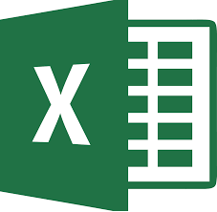

a software program created by Microsoft that uses spreadsheets to organize numbers and data with formulas and functions.
What is Microsoft Excel?

Slide 4

Steps for Powerpoint Presentation:
Go to start
All Programs
Microsoft office
Microsoft office Excel

Slide 5

Let’s Explore….
What is Ribbon?
Ribbon

Slide 6
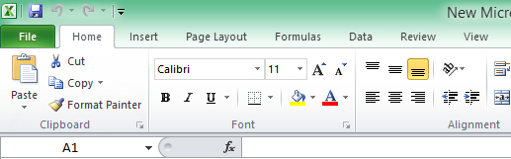

Ribbon :
It is tab to add functions , Operators and Options
It had sub tabs as follow:
Page Layout
Home
Insert
Formulas
Data
View
Review

Slide 7

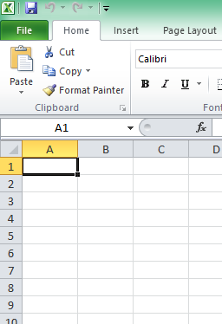

Cells , Columns , Rows……
columns
Cell
Rows

Slide 8
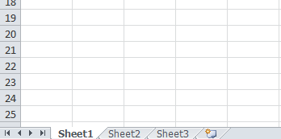

What is sheet ?
Sheets
Worksheet used in Excel documents is a collection of cells organized in rows and columns

Slide 9
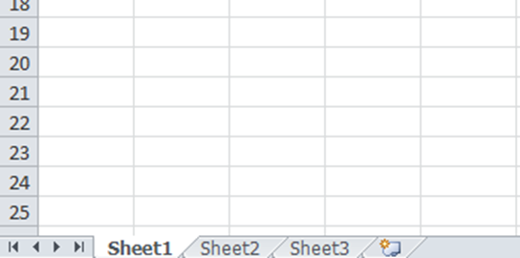
How to add sheets?
Click on this…..

Slide 10
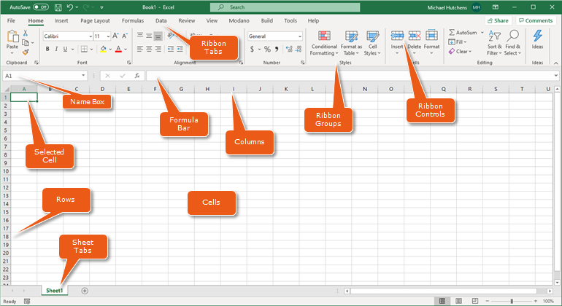

Slide 11

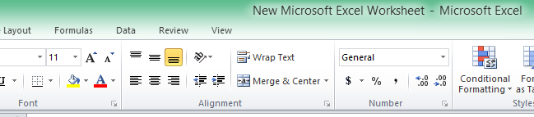
How to Merge Columns or Rows?
Merge & center

Slide 12
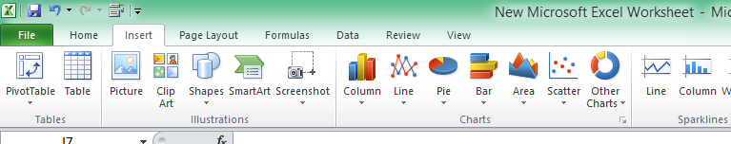
How to Insert Charts?
Charts
Go to insert
Click on Any Charts you want
Types of charts are Column , Line , Pie , Bar , area etc

Slide 13
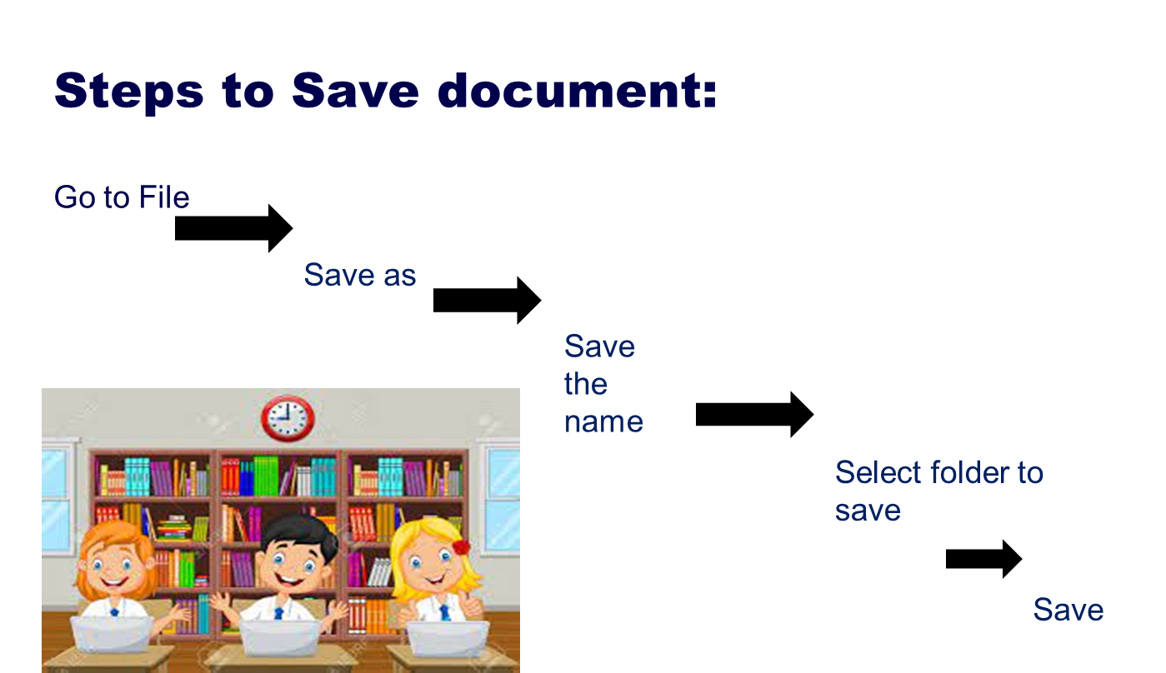

Slide 14

Thank you

